Slide 1
Farmers’ responses to drought
Jonathan Stern, November 2017

Slide 2
My interests
Responses to weather and climate change
Farmers livelihoods and coping with shocks
African context at present.

Slide 3
First paper: responses to weather shocks in Malawi
Questions exploring:
How well do farmers’ perceptions of drought fit with the data?
What is the link between those perceptions and adaptation behaviour?
(eg soil and water conservation, drought resilient maize, alternative crops)?
Do farmers that adapt obtain higher harvests/yields?
Daily rainfall from US National Oceanic and Atmospheric Administration (NOAA)
World Bank Living Standards Measurement Study (LSMS) Malawi 2011 and 2013 panel
MERGED
Notes:
We could say that self reported droughts are in a sense endogenous ie farmers perceptions will be correlated with unobservables such as their perceptiveness, intelligence and memory. However it is the farmers perception and not underlying meteorological reality which drives behaviour. Therefore I could instrument for self reported droughts with a satellite data derived measure of drought. This would only affect behaviour through the drought perception channel and would hopefully correlate with it! It’s also exogenous.

Slide 4
Paper two: a short field/ lab in field experiment in Kenya
If pre-planting a requirement, must be before Feb/ March.
Must be do-able with 1-2 weeks in the field (plus baseline and follow up survey)
Interested in exploring the behavioural economics issues
Policy/ practical relevance important
The question I am interested in “Are there behavioural barriers in the adoption of risk management strategies and techniques among Kenyan farmers?”
…and how can these be overcome?
Notes:
Accessibility to Nairobi will reduce time/ cost (although these are not the most deprived areas in general).

Slide 5
Some relevant themes in (farmer) psychology
Present bias and use of time limited discounts (Duflo, Kremer, Robinson, 2011)
Bayesian updating (Lybbert 2007)
Herd effects (Maertens 2016)
Cognitive bandwidth/load (Lichand/ Mani, Mullainathan & Shafir)
Richard Thaler & Daniel Kahneman: availability bias, framing, unrealistic optimism, priming/ channelling
Informational issues: storytelling (Kahneman), frequencies and probabilities (Slovic et al), conditioning.
BUT: asking questions changes choices- problem for lab context
Notes:
Duflo, Kremer Robinson paper very famous application of behavioural econ- found time limited discounts on fertiliser significantly increased uptake.
Lybbert’s paper explores role of beliefs in knowledge updating. Extends from Slovic’s idea of “risks as feelings.” Nomadic pastoralists in Kenya could access weather information but essentially not change their beliefs. Lybbert raises the question as to whether adaptation strategies available to nomadic pastoralists are actually effective since although farmers update their beliefs, they don’t significantly change practices.
Herd effects: originating with Thaler, but Annemie looked specifically at adoption of BT cotton in India through a bespoke survey. Found that farmers looked to a select group of ‘experimental’ farmers to influence their decisions, essentially free riding on their risk taking.
Cognitive load: Mani et al (2013): Cognitive bandwidth taken up at planting time relative to harvest time, risk of higher rainfall increases cognitive load. This is tested using a series of mental tests. Lichand and Mani working paper extends this by looking at how thinking about drought risk induces cognitive load.
Thaler points: The availability heuristic helps to explain much risk-related behaviour, including both public and private decisions to take precautions. Whether people buy insurance for natural disasters is greatly affected by recent ex- periences.6
When “availability bias” is at work, there is potential to nudge in direction of true probabilities. A good way to increase people’s fear of a bad outcome is to remind them of a related incident in which things went wrong; a good way to increase people’s confidence is to remind them of a similar situation in which everything worked out for the best. The pervasive problems are that easily remembered events may inflate people’s probability judgments, and that if no such events come to mind, their judgments of likelihoods might be distorted downward.
According to Thaler, unrealistic optimism characterizes most people in most social categories. When they overestimate their personal immunity from harm, people may fail to take sensible preventive steps. If people are running risks because of unrealistic optimism, they are nudge-able. - if people are reminded of a bad event, they may not continue to be so optimistic. Does this run counter to the messaging around cognitive bandwidth/ load? Maybe not- recent/ present worries cause cognitive load, more abstract ones subject to availability (negative) bias.
Just asking a q can change choices
P70 A study of a nationally representative sample of more than forty thousand people asked a simple question: Do you intend to buy a new car in the next six months?23 The very question increased purchase rates by 35 per- cent. O
Priming and Channelling: more likely to adopt if led to create a specific plan, rather than just given info:
Leventhal, Singer, and Jones (1965) on the campus of Yale University. Primed subjects to worry about tetanus. Found those provided with a specific plan including location of clinic, day they would go etc more likely to actually go than those only primed to worry. Both groups provided info about vaccinations.

Slide 6
Summary: how do farmers respond to drought risk?
Financial situation/outside options
Personal/ HH weather experience
Cognitive load
-
Availability bias
Choice of adaptation measures: do nothing, insurance, DT varieties, cash crops, off farm income, EXIT!
‘income effect’
-
Status quo bias
Perceptions about drought risk
‘substitution effect’
Focus on managing risk
+
Climate/ weather info
Optimism bias, trust, availability, get the gist
Perceptions about adaptation options
Trust in provider, salience, get the gist
Info about adaptation options
Peers, extension, radio, SMS
Availability/ price of adaptation options
Herd effects, free riding
Availability bias
(How well) Did it work?

Slide 7
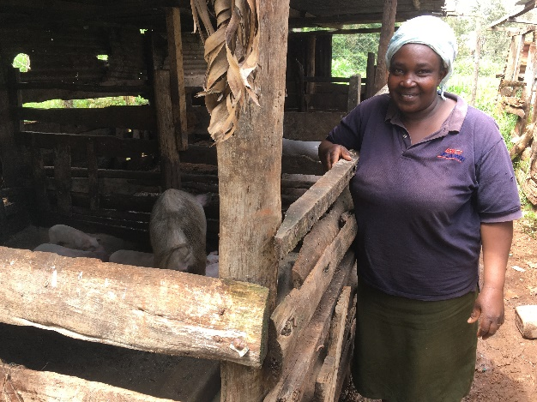
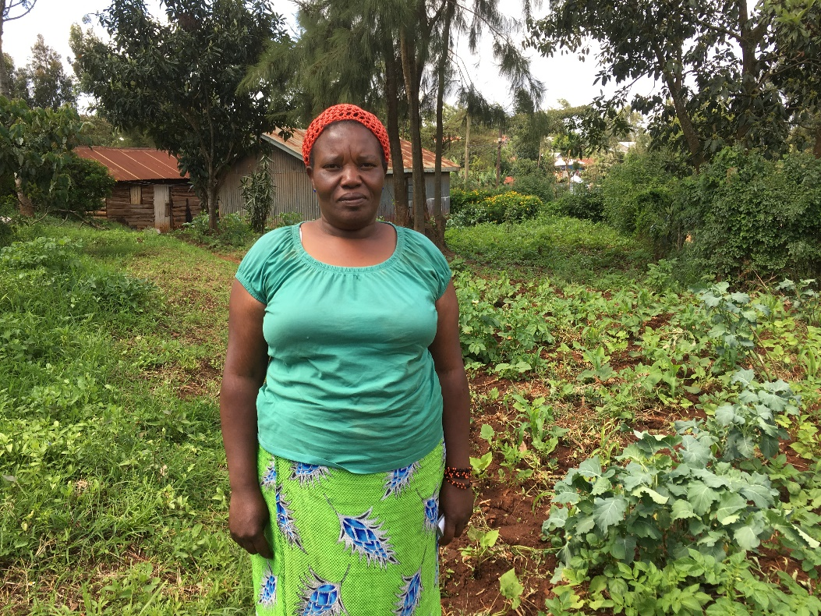
Qualitative Fieldwork, November 2017
Eight semi-structured interviews in two drought affected locations 60-90 minutes from Nairobi.

Slide 8
Key findings:
Small scale farmers (<10 acres) more severely affected by 2017 drought than larger scale ones.
Most prevalent resilience strategies: off farm income and livestock rearing.
Use of drought resilient maize is widespread; however most farmers not registering for free insurance.
Notes:
; smaller farmers in many cases they were forced to restrict their meal intake while those on larger farms merely put off long run investments.

Slide 9
More on the fieldwork
Other interesting/ useful findings:
Farmers widely received weather information from radio/ TV. However widespread mistrust of the forecast.
Farmers were distressed by the long rains 2017 forecast but did not act on it (investment decisions already taken, mistrust). Farmers were not distressed/ worried by our interviews.
Commonplace to relax/ take time off in the afternoon: farmers not working all hours.
Other potential barriers to risk management: fatalism, religiosity.
Another question: do farmers buy their inputs at the optimal time?

Slide 10
Next steps:
Have been working on an experimental design involving priming farmers to worry about drought risk and introducing ‘treatments’ such as adaptation plans, varying information timing.
However fieldwork and discussions have highlighted difficulties.
Other option: diagnostic study on effect of cognitive load and risk aversion on adoption of drought tolerant maize and crop insurance.
Jan/ Feb: lab in field to determine cognitive load and risk aversion, baseline data
September: Collect harvest data and measure cognitive load again.
Notes:
Baseline: farmers set out their plans for the coming growing season. We also test cognitive load in response to weather forecast.
In an ideal case we would be able to give farmers the choice to buy/ commit to some of their ideas at the meeting.
Failing that , their plans are simply recorded as well as their cognitive load state. Then the treatment proceeds through offering reminders at different times of day of time remaining until rains expected,

Slide 11
An observational study with experimental derivation of key variables
Study determinants of DT maize and insurance uptake, using lab in field methods to capture key cognitive variables: cognitive load, risk aversion, time inconsistency (?).
Use satellite rainfall data to measure past rain shocks (and potentially stratify sample according to past shock/ no shock).
Overall question: how does farmer psychology affect the adoption of risk management strategies?
Follow up at harvest time to see whether those farmers were made better off by their choice, and re-measure cognitive load.
Difficulty: How can we pick apart effects of financial liquidity from cognitive load?
Without randomized treatment, there will be OVB and selection issues.
Notes:
Financial liquidity and cognitive load: according to Mullainathan and Shafir causation could run both ways here. One Acre believe financial liquidity is the more important driver.
Essentially the Mullainathan and Shafir (2013) world sees financial liquidity as one of the causal drivers of cognitive load.
I wonder whether we would also want to try to test time inconsistency using intertemporal tradeoffs between money now and harvest later (through investing in improved seed for example) in different growing seasons.

Slide 12
How does this add value ?
Unlikely to find ready datasets that measure risk aversion and almost certainly won’t find cognitive load. Measuring cognitive load at different points in the cycle (harvest, planting, germination etc) novel.
More importantly, Mani & Lichand found that farmers suffering from cognitive load made hypothetical choices away from risk management (less likely to choose crop insurance option). Can test with real data.
Can also test whether risk aversion and cognitive load work ‘through separate channels’.
Notes:
Some survey evidence agriculture for Kenya from CIAT (worth looking at in more detail); no Kenya LSMS data
https://dataverse.harvard.edu/dataset.xhtml?persistentId=doi:10.7910/DVN/K6JQXC&version=1.2

Slide 13
(New) Experimental ideas
Prime farmers to induce cognitive load by requiring them to carry out difficult/ multiple tasks => then ask about adoption plans.
Combine with providing information about eg DT maize & insurance- how does cognitive load affect processing of information?
Could also vary the format of information (frequencies/ probabilities) or the information provider (me, an agronomist…)
Contribution: other studies have looked at processing of insurance information but not actual behaviour.

Slide 14
How does cognitive load affect processing of information about drought mitigation?
Time= -1
Time=0 (pre-planting)
Time=1 (post planting AND/OR harvest)
T: PRIME: multiple/ difficult task exercise
Baseline survey
Mental tests for Cognitive load and ask about adoption plans
Provide information about adaptations: DT maize, crop insurance
Observe adoption behaviour and ask about reasons?
T2: Information, No priming
C: no priming or information
T3: Priming, no information
Notes:
Mental tests for cognitive load employed in the literature include Raven’s matrices, stroop tests. It would also be interesting to explore what socioeconomic and individual characteristics are associated with raised cognitive load- eg in the Leventhal, Singer, and Jones (1965) paper, self esteem was negatively correlated with susceptibility to cognitive load.

Slide 15
Thanks for listening!

Slide 17
Risk aversion and cognitive load: lab in field more information
Following Maertens (2014) Why farmers love risk could explore farmers Willingness To Pay for different hypothetical distributions (of income?), including a typical DT maize crop and a DT maize crop with crop insurance.
Compare this to actual observed choices- do farmers actual choices of risk management techniques match their hypothetical stated preferences?
Also measure cognitive load and see how this correlates with measured risk aversion. Are these really separate channels?
There could be a role for priming here to see a) how if affects measured cognitive load and b) how this affects measured risk aversion as we can pick up the short term effect without worrying about it wearing off.
Notes:
Note Lichand and Mani (2015) state that cognitive load does not operate through the risk aversion channel. If we have observed adaptation behaviour, we can regress this on load and risk aversion variables. They should be individually significant. Also the interaction variable of the two should be insignificant, ie risk aversion has no different effect in the presence of load and vice versa. –I’m not sure about this. I assume risk aversion should be stable through time but perhaps not (attitudes to risk will be directed by affect [Slovic, Kahneman and Tversky]).

Slide 18
Expected patterns of cognitive load and financial liquidity
Nov | Dec | Jan | Feb | March | Apr | May | Jun | July | Aug | Sep | Oct
Short rains
HARVEST
PLANT
Long rains
HARVEST
PLANT
Financial liquidity
Investing in seed, inputs
Measure?
Measure?
Measure?
Cognitive load
Mani et al find load low at harvest time but high at planting. This implies large increase here.
Assuming: normal harvest (so that harvest releases income and reduces stress). Germination releases stress (but has no financial effect). Anticipation builds toward harvest with load rising.

Slide 19

Example Raven’s matrix

Slide 20
What I still need/ would like to know: baseline study
Local context (study site dependent):
Climate/ weather info received and media for this.
Baseline level of uptake of drought resilience measures and perceptions about these: insurance, DT varieties, cash crops, off farm income, support networks available.
Historical weather/ climate (can link to satellite weather data for this if prefer not to ask, instead just need location)
Perceptions about drought risk (can use to assess availability, optimism).
Level of cognitive load (test through mental tasks)

Slide 21
Technology specific studies
Cole et al (2013): Farmers very price sensitive to index insurance and even adopters likely to under-insure. Trust, salience and liquidity constraints also relevant.
Some climate science literature argues there is a failure to consider the best ways to get weather/ climate information to the farmer (Stone et al 2006).
Is there a need to pick winners? Leave technology choice to the farmer…?
Notes:
Cole et al (2013) Barriers to Household Risk Management: Evidence from India American Economic Journal: Applied Economics
In this paper Cole and colleagues conducted a randomized field experiment in India. This included randomly offering discounts on insurance to farmers as well as experimenting with the framing of insurance information and whether the product was endorsed by a ‘trusted local agent’. Farmers very price sensitive and even adopters likely to under-insure. Trust and liquidity constraints also relevant. Salience: a visit from an agent providing information about a product readiliy available on the market had a significant effect on takeup.

Slide 22
Other areas that could be investigated relating to drought preparedness and mitigation…
How vulnerable is the rural population- drought effect on crop yields, incomes, recent study on food prices and birthweight (Grace et al 2014)
Related: how do farmers perceive weather shocks- recall bias, herd effects, denial??
How well do the various policies/ initiatives work and how could they work better ?
Effectiveness of food aid/ cash transfers (eg OPM recently evaluated the Hunger Safety Net Programme in Kenya)- this would require partnering with an organisation rolling out such a programme: desirable but not really feasible in this time frame.

Slide 23
Response to shocks: seminal papers
Agricultural household model ([cite paper in handbook])
Risk management strategies in the presence of credit/ insurance constraints (Rosensweig and Binswanger, 1993, Economic Journal)
Risk pooling within households (Dercon and Krishnan, 2000)
Perverse labour market outcomes (Jayachandran, 2006, JPE)
Effects of climate change/ weather shocks on yield (eg Deschenes and Greenstone, 2007, AER)
Notes:
Ag household model is the workhorse model in agricultural economics for looking at HH decision making. It differs from the standard consumer or producer models in the simple sense that the two are combined into one, and this simple insight has enabled explanation of eg why farmers might reduce output when the price of a staple rises (eg because a positive income effect causes increased leisure time??)
Agricultural household model predictions uncertain in presence of shocks ([cite paper in handbook])
Risk management strategies in the presence of credit constraints can lead to reduced (expected) welfare (Rosensweig and Binswanger, 1993, Economic Journal)
Risk pooling in households may be asymmetric/ gendered (Dercon and Krishnan, 2000)
Lack of alternative livelihood options leads to over-supply of unskilled labour and reduced wages (Jayachandran, 2006, JPE)
Recent literature interested in climate shocks (eg Deschenes and Greenstone, 2007, AER)

